Slide 1
Product Data Analysis
Muhammad Ahmad Aziz

Slide 2
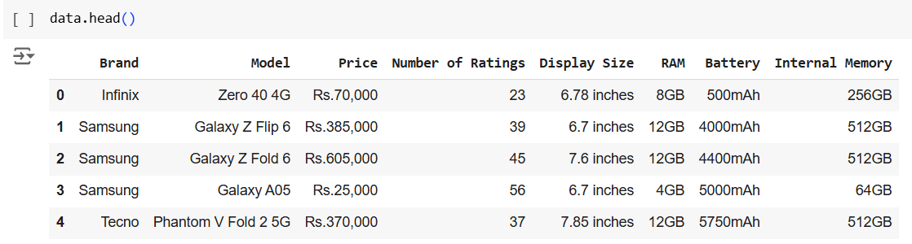
Overview of the Dataset
Dataset Size: 1345 rows and 8 columns.
This dataset contains information about various smartphone models from different brands, capturing key specifications and features.
The data provides insights into the diversity of smartphones, catering to a wide range of users based on performance, design, and affordability.
A clean dataset is crucial for accurate predictions and insights so that future modeling tasks can be performed efficiently.

Slide 3
Objectives of the Project
The objective of this project is to predict the price of a smartphone based on its specifications.
By analyzing this dataset, we aim to understand how features like display size, RAM, battery capacity, and internal memory influence the pricing of smartphones.
This prediction model can help manufacturers, retailers, and consumers make informed decisions regarding smartphone pricing and purchases

Slide 4
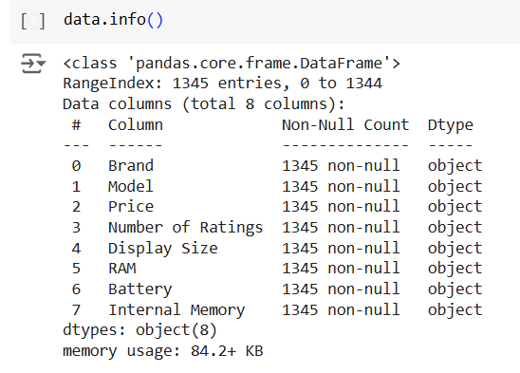
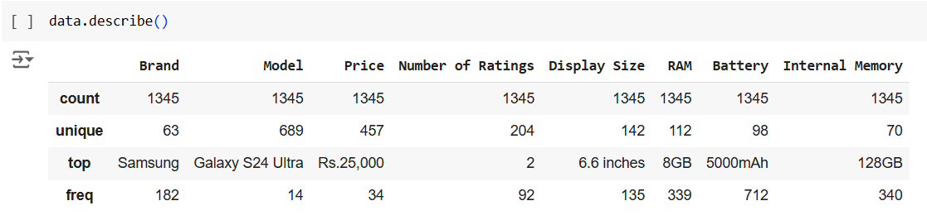
Key finding from data exploration
The count of every column, unique values, max values, data types are mentioned in the pictures from data exploration.

Slide 5
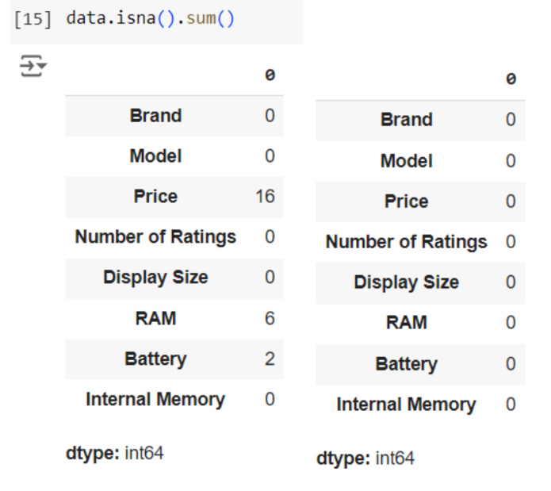
Data Cleaning - Handling Missing Data
Some columns including price, RAM and battery had some missing values. The threshold was set to 5%. The count of all the rows with missing values was below the threshold, so they were removed from the dataset.

Slide 6
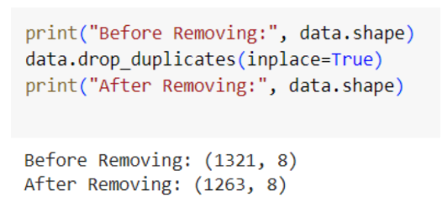
Data Cleaning - Duplicate Removal
The dataset was cleaned using the drop_duplicates() function. Duplicates were successfully removed which can be seen in the figure.

Slide 7
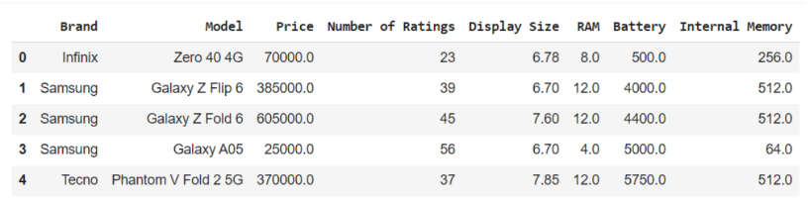
Data Cleaning - Data Type Conversion
Price, Number of Ratings, Display size, RAM, Battery and Internal Memory columns were converted into numeric columns by using their respective functions and removing Rs, inches, GB, mAh respectively from the columns.

Slide 8
Data Cleaning - Outlier Detection
Outliers were detected using the Interquartile Range (IQR) method.
The columns analyzed for outliers included Number of Ratings, RAM, and Internal Memory.
Boxplots were generated to visualize outliers before and after their removal.
Rows containing outliers were removed to ensure a clean dataset for further analysis.
The outliers in Price and Display Size were not removed as these columns have such information which should not be removed.

Slide 9
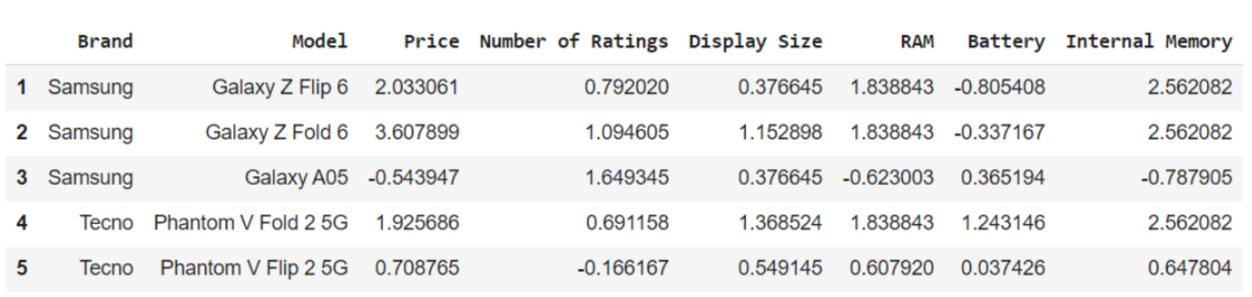
Data Transformation
Standardization was performed on the following columns (Price, Number of Ratings, Battery, RAM, Display Size, Internal Memory) using StandardScaler().
Scaling transformed the dataset into a form that is more suitable for machine learning models, normalizing the values to a standard scale (mean of 0 and variance of 1).

Slide 10
Univariate Analysis - Histograms

Slide 11
Univariate Analysis - Boxplots

Slide 12
Univariate Analysis - Pie Chart

Slide 13
Bivariate Analysis

Slide 14
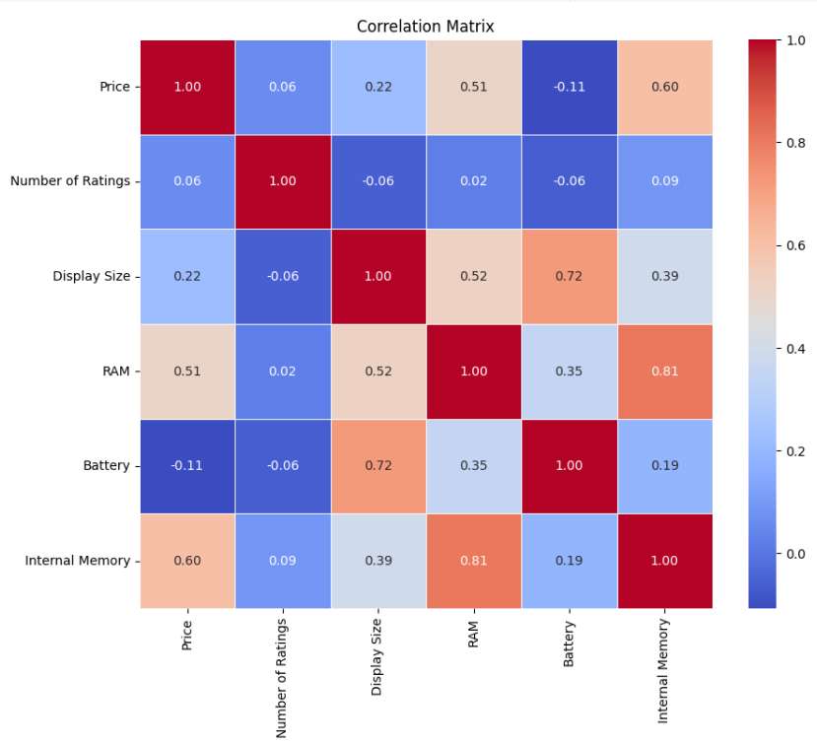
Correlation Matrix

Slide 15
Multivariate Analysis

Slide 16
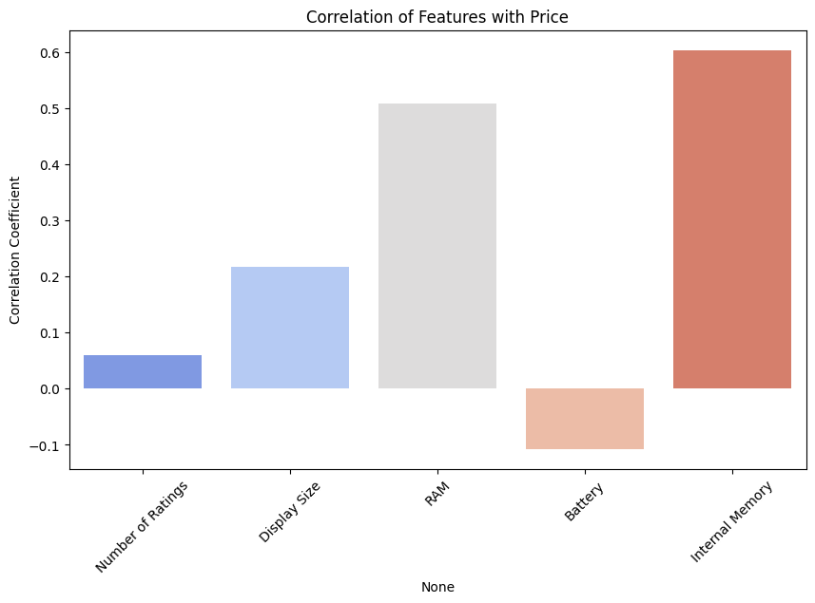
Feature Analysis

Slide 17
Models used in Project
For this project, Random Forest and Neural Networks were chosen as the primary models for addressing the problem of price prediction.
Random Forest:
A machine learning algorithm well-suited for regression tasks.
Capable of handling non-linear trends in data due to its ensemble nature, combining multiple decision trees to enhance predictive accuracy and reduce overfitting.
Chosen for its robustness and ability to handle complex relationships between features and the target variable.
Neural Networks:
A deep learning model that excels in capturing intricate patterns and non-linear relationships in data.
Particularly suitable for this regression problem where the underlying trends are non-linear, making traditional linear models insufficient.
Provides flexibility in learning from large datasets, adjusting to hidden patterns that may not be evident in simpler models.
The selection of these models reflects the non-linear nature of the data and the objective to achieve accurate price predictions while leveraging the strengths of both machine learning and deep learning approaches.

Slide 18
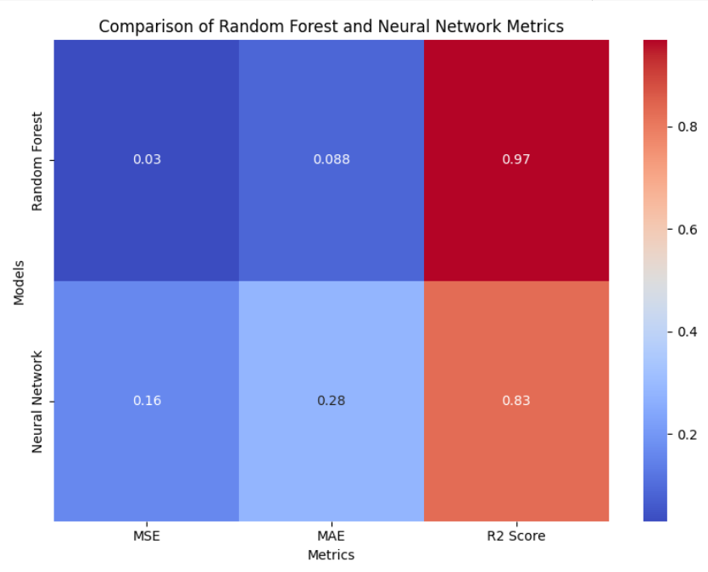
Comparison
The Random Forest model has a significantly lower MSE (0.03) compared to the Neural Network model (0.16), indicating better prediction accuracy for the Random Forest model.
Random Forest also outperforms the Neural Network in terms of MAE, with a value of 0.088 versus 0.28 for the Neural Network, reflecting lower average errors in predictions.
While both models show strong explanatory power, the Random Forest model has a higher R² score of 0.97, compared to the Neural Network's 0.83, suggesting better overall fit for the Random Forest model.

Slide 19
Future Directions
Feature Expansion: Incorporating additional features, such as camera specifications, processor type, and connectivity options, may further improve the model's predictive accuracy.
Dynamic Pricing Analysis: Extending the model to account for temporal trends in pricing, influenced by market dynamics, seasonality, or brand value.
Real-time Deployment: Developing a real-time prediction system integrated into a web or mobile application to assist users in price comparison and decision-making.
Regional and Demographic Insights: Analyzing regional variations in pricing trends and user preferences to tailor insights for different markets.

Slide 20
Conclusion
This project successfully developed a predictive model to estimate smartphone prices based on key specifications like display size, RAM, battery capacity, and internal memory.
Specifications like RAM and internal memory showed a significant correlation with price, whereas battery capacity and display size showed weaker relationships.
Random Forest and Neural Networks demonstrated the ability to handle non-linear relationships effectively. Random Forest provided robust predictive performance while Neural Networks captured complex patterns in the data.
Metrics such as MSE, MAE, and R² confirmed the reliability and accuracy of the models, with Random Forest outperforming in terms of error magnitude and explanatory power.

